Slide 1
Digital Portfolio
STUDENT NAME: S.KIRUTHIKA
REGISTER NO AND NMID: 222407498
DEPARTMENT: B.Sc Computer Science
COLLEGE: MAHALASHMI WOMEN`S COLLEGE OF ARTS & SCIENCE

Slide 2
TASK MANAGER

Slide 3


AGENDA
Problem Statement
Project Overview
End Users
Tools and Technologies
Portfolio design and Layout
Features and Functionality
Results and Screenshots
Conclusion
Github Link
3/21/2024 Annual Review

Slide 4

PROBLEM STATEMENT
In today’s busy life, people often forget tasks and deadlines.
Managing tasks on paper is time-consuming and unorganized.
Users need a lightweight digital task manager that:
Works directly in the browser
Requires no installation or login
Allows quick adding, deleting, and completing of tasks
The solution: A frontend Task Manager using HTML, CSS, and JavaScript.

Slide 5

PROJECT OVERVIEW
The Task Manager is a browser-based application.
It allows users to:
Add multiple tasks
Mark tasks as completed
Delete unwanted tasks
Maintain a simple digital to-do list
Fully developed using only HTML, CSS, and JavaScript – no backend or database required.
Lightweight and accessible on any modern browser.

Slide 6

WHO ARE THE END USERS?
Students→ For tracking assignments, exams, and study schedules.
Professionals → For organizing work-related tasks and deadlines.
General Users → For personal goals, shopping lists, and daily routines.
Freelancers → To manage client tasks and project deadlines

Slide 7

TOOLS AND TECHNIQUES
HTML (Hyper Text Markup Language) → To design the structure of the app (task input box, buttons, task list).
CSS (Cascading Style Sheets) → For styling , colours , layout, and responsive design.
JavaScript → For task operations like add, delete, and complete.
Browser Local Storage (Optional) → To save tasks temporarily, even after refreshing.
GitHub → For version control and project hosting.

Slide 8
POTFOLIO DESIGN AND LAYOUT
Header Section : App title “Task Manager”.
Input Section : A text box and “Add Task” button.
Task List Section : Displays all pending and completed tasks.
Buttons : For deleting or marking tasks as complete.
Design Features :
Minimal and clean UI
Responsive design for desktop and mobile
Attractive colors and hover effects for buttons
8

Slide 9
FEATURES AND FUNCTIONALITY
Add Task → User can type and add new tasks.
Delete Task → Remove unwanted tasks from the list.
Mark Complete → Strike-through completed tasks for better clarity.
Clear All Tasks → Reset the entire list in one click.
Lightweight → No backend required, runs entirely in browser.
Responsive → Works on laptop, tablet, and mobile.
User-Friendly → Simple interface, easy navigation.

Slide 10
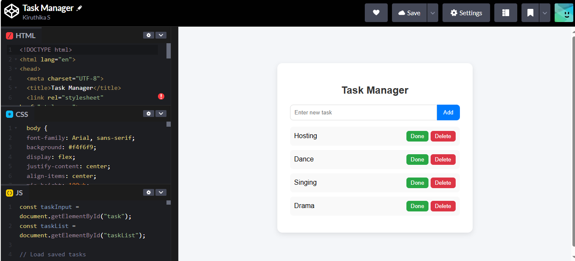

RESULTS AND SCREENSHOTS
3/21/2024 Annual Review
10

Slide 11
CONCLUSION
The Task Manager is a simple, efficient, and lightweight web application.
It helps users stay organized, improve productivity, and manage tasks effectively.
Built entirely using HTML, CSS, and JavaScript, without external dependencies.
Can be enhanced further with features like:
Priority levels for tasks
Notifications and reminders
Drag-and-drop task ordering
Dark mode support
11

